Slide 1
Feasibility Study instructor: Rwagaju Aphrodice RCA
Analyzing and developing system requirements

Slide 2
Feasibility Study
What is a feasibility study?
It is an assessment of practicality of a proposed system and how beneficial its implementation will be to an organization.
Types of feasibility
Technical
Operational
Economic
Schedule
Quantifying benefits and costs
Payback analysis
Net Present Value Analysis
Return on Investment Analysis
Comparing alternatives

Slide 3
Feasibility - Why a feasibility study?
Objectives:
To find out if a system development project can be done:
...is it possible?
...is it justified?
To suggest possible alternative solutions.
To provide management with enough information to know:
Whether the project can be done
Whether the final product will benefit its intended users
What the alternatives are (so that a selection can be made in subsequent phases)
Whether there is a preferred alternative
A management-oriented activity:
After a feasibility study, management makes a “go/no-go” decision.
Need to examine the problem in the context of broader business strategy

Slide 4
Feasibility - Content of a feasibility study
Things to be studied in the feasibility study:
The present organizational system
Stakeholders, users, policies, functions, objectives,...
Problems with the present system
inconsistencies, inadequacies in functionality, performance,…
Goals and other requirements for the new system
Which problem(s) need to be solved?
What would the stakeholders like to achieve?
Constraints
including nonfunctional requirements on the system (preliminary pass)
Possible alternatives
“Sticking with the current system” is always an alternative
Different business processes for solving the problems
Different levels/types of computerization for the solutions
Advantages and disadvantages of the alternatives
Things to conclude:
Feasibility of the project
The preferred alternative.

Slide 5
Feasibility - Exploring Feasibility
The “PIECES” framework
Useful for identifying operational problems to be solved, and their urgency
Performance
Is current throughput and response time adequate?
Information
Do end users and managers get timely, pertinent, accurate and usefully formatted information?
Economy
Are services provided by the current system cost-effective?
Could there be a reduction in costs and/or an increase in benefits?
Control
Are there effective controls to protect against fraud and to guarantee information accuracy and security?
Efficiency
Does current system make good use of resources: people, time, flow of forms,…?
Services
Are current services reliable? Are they flexible and expandable?

Slide 6
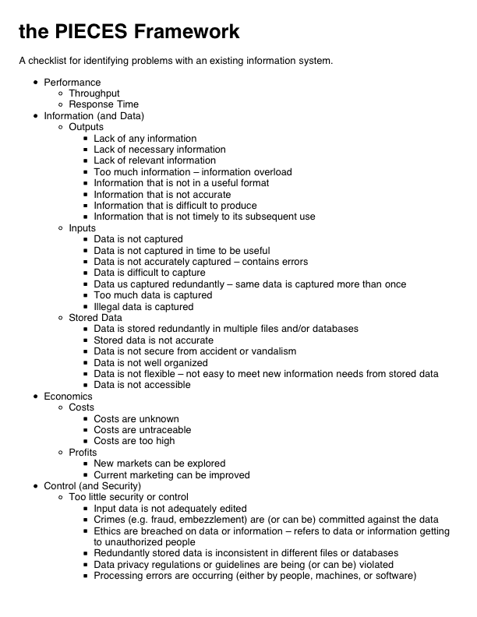
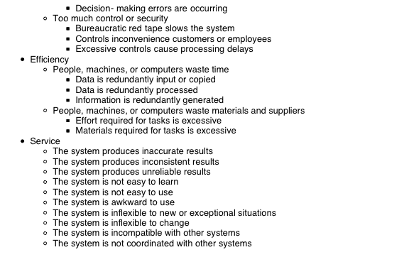
Feasibility - Exploring Feasibility

Slide 7
Feasibility - Feasibility Checkpoints
Planning
Planned Project
Existing System
Support
Analysis
Production
System
System
Requirements
Implementation
Design
Technical
Design

Slide 8
Feasibility - Four Types of feasibility
Technical feasibility
Is the project possible with current technology?
What technical risk is there?
Availability of the technology:
Is it available locally?
Can it be obtained?
Will it be compatible with other systems?
Operational feasibility
If the system is developed, will it be used?
Human and social issues…
Potential labour objections?
Manager resistance?
Organizational conflicts and policies?
Social acceptability?
legal aspects and government regulations?
Economic feasibility
Is the project possible, given resource constraints?
What are the benefits?
Both tangible and intangible
Quantify them!
What are the development and operational costs?
Are the benefits worth the costs?
Schedule feasibility
Is it possible to build a solution in time to be useful?
What are the consequences of delay?
Any constraints on the schedule?
Can these constraints be met?

Slide 9
Feasibility - Technical Feasibility
Is the proposed technology or solution practical?
Do we currently possess the necessary technology?
Do we possess the necessary technical expertise
…and is the schedule reasonable for this team?
Is relevant technology mature enough to be easily applied to our problem?
What kinds of technology will we need?
Some organizations like to use state-of-the-art technology
…but most prefer to use mature and proven technology.
A mature technology has a larger customer base for obtaining advice concerning problems and improvements.
Is the required technology available “in house”?
If the technology is available:
…does it have the capacity to handle the solution?
If the technology is not available:
…can it be acquired?

Slide 10
Feasibility - Economic Feasibility
Can the bottom line be quantified yet?
Very early in the project…
a judgement of whether solving the problem is worthwhile.
Once specific requirements and solutions have been identified…
…the costs and benefits of each alternative can be calculated
Cost-benefit analysis
Purpose - answer questions such as:
Is the project justified (I.e. will benefits outweigh costs)?
What is the minimal cost to attain a certain system?
How soon will the benefits accrue?
Which alternative offers the best return on investment?
Examples of things to consider:
Hardware/software selection
Selection among alternative financing arrangements (rent/lease/purchase)
Difficulties
benefits and costs can both be intangible, hidden and/or hard to estimate
ranking multi-criteria alternatives

Slide 11
EXAMPLE OF Cost for IMPLEMENTATION OF COVID-19 VACCINE supply CHAIN MIS

Slide 12
EXAMPLE OF Cost for IMPLEMENTATION OF COVID-19 VACCINE supply CHAIN MIS

Slide 13
EXAMPLE OF Cost for IMPLEMENTATION OF COVID-19 VACCINE supply CHAIN MIS

Slide 14
Feasibility - Analyzing Costs vs. Benefits
Identify costs and benefits
Tangible and intangible, one-time and recurring
Assign values to costs and benefits
Determine Cash Flow
Project the costs and benefits over time, e.g. 3-5 years
Calculate Net Present Value for all future costs/benefits
determines future costs/benefits of the project in terms of today's dollar values
A dollar earned today is worth more than a potential dollar earned next year
Do cost/benefit analysis
Calculate Return on Investment:
Allows comparison of lifetime profitability of alternative solutions.
ROI = Total Profit x 100 = Lifetime benefits - Lifetime costs x 100
Total Cost Lifetime costs
Calculate Break-Even point:
how long will it take (in years) to pay back the accrued costs:
@T (Accrued Benefit > Accrued Cost)

Slide 15
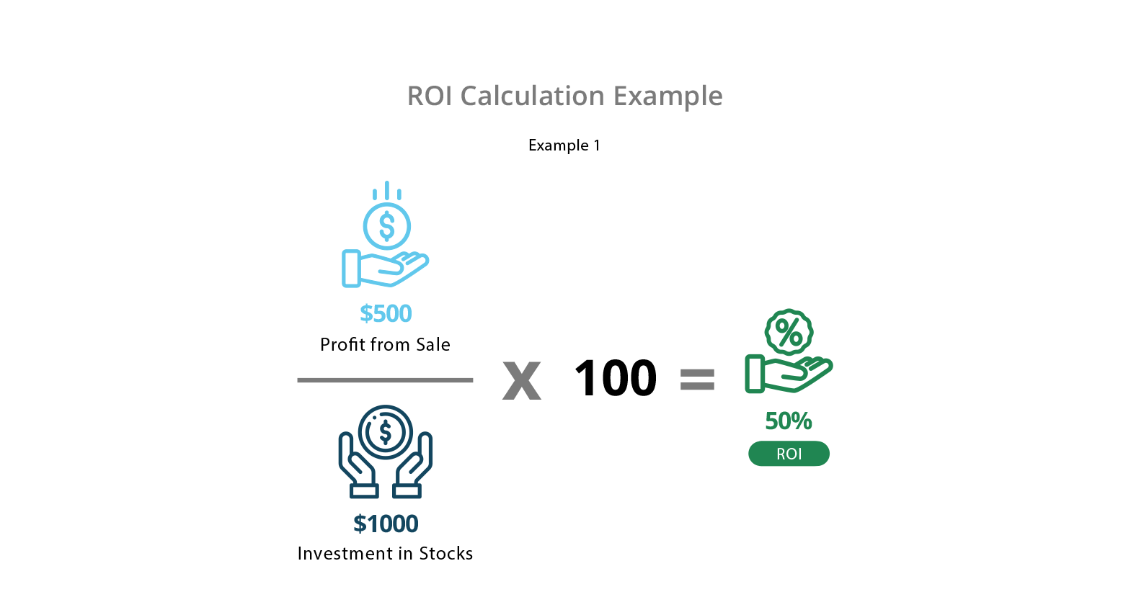
FEASIBILITY – ROI Example 1

Slide 16
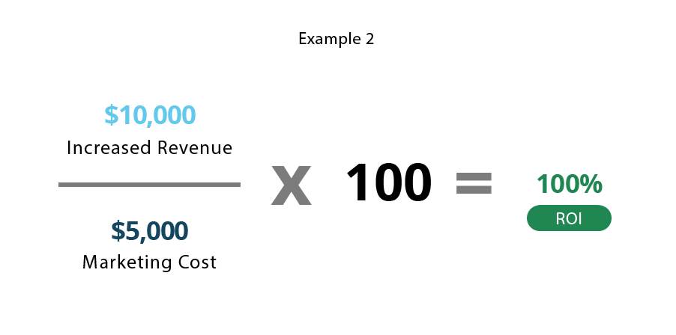
FEASIBILITY – ROI EXAMPLE 2

Slide 17

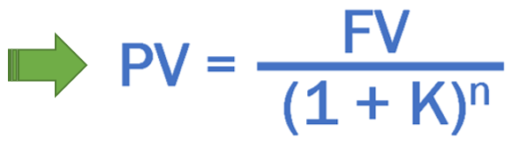
Feasibility – TIME Value Of money
A dollar today is worth more than a dollar tomorrow…
Your analysis should be normalized to “current year” dollar values.
Why?
Depreciation
Money grows over time when it earns interest
The time value of money brings us the concept of
Future value (FV) of money
Present value (PV) of money
The relationship between FV and PV
FV = Future value
PV = Present value
K = Discounted rate in %
n = Number of years

Slide 18
Feasibility - Calculating Present Value
The discount rate
measures opportunity cost:
Money invested in this project means money not available for other things
Benefits expected in future years are more prone to risk
This number is company- and industry-specific.
“what is the average annual return for investments in this industry?”
Present Value:
The “current year” dollar value for costs/benefits n years into the future
… for a given discount rate i
Present_Value(n) = 1
(1 + i)^{n}
E.g. if the discount rate is 12%, then
Present_Value(1) = 1/(1 + 0.12)¹ = 0.893
Present_Value(2) = 1/(1 + 0.12)² = 0.797
Present_Value(3) = 1/(1 + 0.12)³ = 0.712
Etc …

Slide 19
Feasibility - Net Present Value
Measures the total value of the investment (net loss or net profit of the project)
…with all figures adjusted to present dollar values
NPV = Cumulative PV of all benefits - Cumulative PV of all costs
Assuming subsequent years are like year 5…
the net present value of this investment in the project will be:
after 5 years, $31,929.86
after 6 years, $72,033.56

Slide 20
Feasibility – Decision based on NPV
Investment decision based on NPV
If the NPV > 0 (NPV is positive, Accept the project)
If the NPV < 0 (NPV is negative, Reject the project)
If the NPV = 0 (Accept the project considering other non tangible profits)

Slide 21
Feasibility - Computing the payback period
Can compute the break-even point:
when does lifetime benefits overtake lifetime costs?
Determine the fraction of a year when payback actually occurs:
| Beginning year amount |
End year amount + | Beginning year amount |
For our last example, 8,243.74 / (31,929.86 + 8,243.74) = 0.20
Therefore, the payback period is approximately 4.2 years
If we plan to get profit after 4.2 years, we can accept the project.

Slide 22
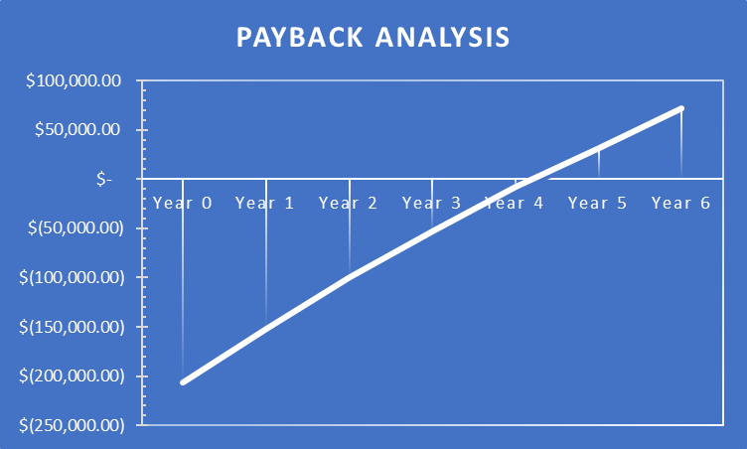
Feasibility - Exploring Feasibility

Slide 23
Feasibility - Return on Investment (ROI) analysis
For comparing overall profitability
Which alternative is the best investment?
ROI measures the ratio of the value of an investment to its cost i.e percentage of return relative to the investment cost
ROI is calculated as follows:
ROI = Estimated lifetime benefits - Estimated lifetime costs x100 Estimated lifetime costs
or:
ROI = (Net Present value / Estimated lifetime costs) x 100
For our example (in 5 years)
ROI = (356,435 – 324,505.14) / 324,505.14 ≈ 9.83%,
or ROI = 31,929.86 / 324,505.14 ≈ 9.83%
Solution with the highest ROI is the best alternative
But need to know payback period too to get the full picture
E.g. A lower ROI with earlier payback may be preferable in some circumstances

Slide 24
Feasibility – Internal rate of return (IRR)
IRR
IRR is the interest rate in which the Net Present Value (NPV) of all cash flows of an investment equal to zero.
IRR is the same as the NPV but in IRR we calculate the discount rate to arrive at Zero (0) NPV.
If the IRR is higher than the discount rate, it is a good project to pursue.
If the project’s NPV is above Zero (0), it is financially worthwhile.

Slide 25
Feasibility – Profitability index
PI
For every dollar spent, how much are we getting back
Criteria
If PI >= 1 , Accept the project
If PI< 0 , Reject the project
Exercise (for more details, please refer to shared excel sheet)

Slide 26
Feasibility – Economic feasibility tips
Few tips to consider during economic feasibility study
Always choose the project with the highest NPV
If NPV is the same for given projects, choose the project with the highest IRR
If NPV, IRR remain the same for the given projects, choose the project with early payback period
NPV = All cash inflows – cash outflows
Greater the NPV, better the prospects
PI = All cash inflows / cash outflows
ROI = (Lifetime benefits – Lifetime costs) / Lifetime benefits i.e Total profits / Total costs ????
IRR = Discount rate at which the NPV becomes zero. This tells us what is the percent of the return for the project
BEP = How long will it take to pay back the accrued costs (in years)
Payback period (PBP) is a major consideration for every project, business or organization. It tells us how soon we can recover our investment and this investment can utilized for other business needs/project later on
As conclusion, while making any investment, we should thoroughly evaluate these parameters as it gives us the holistic picture of the expected gains or losses.

Slide 27
Feasibility - Schedule Feasibility
How long will it take to get the technical expertise?
We may have the technology, but that doesn't mean we have the skills required to properly apply that technology.
May need to hire new people
Or re-train existing systems staff
Whether hiring or training, it will impact the schedule.
Assess the schedule risk:
Given our technical expertise, are the project deadlines reasonable?
If there are specific deadlines, are they mandatory or desirable?
If the deadlines are not mandatory, the analyst can propose several alternative schedules.
What are the real constraints on project deadlines?
If the project overruns, what are the consequences?
Deliver a properly functioning information system two months late…
…or deliver an error-prone, useless information system on time?
Missed schedules are bad, but inadequate systems are worse!

Slide 28
Feasibility - Operational Feasibility
How do end-users and managers feel about…
…the problem you identified?
…the alternative solutions you are exploring?
You must evaluate:
Not just whether a system can work…
… but also whether a system will work.
Any solution might meet with resistance:
Does management support the project?
How do the end users feel about their role in the new system?
Which users or managers may resist (or not use) the system?
People tend to resist change.
Can this problem be overcome? If so, how?
How will the working environment of the end users change?
Can or will end users and management adapt to the change?

Slide 29
Feasibility - Feasibility Study Contents
Purpose & scope of the study
Objectives (of the study)
who commissioned it & who did it,
sources of information,
process used for the study,
how long did it take,…
Description of present situation
organizational setting, current system(s).
Related factors and constraints.
Problems and requirements
What’s wrong with the present situation?
What changes are needed?
Objectives of the new system.
Goals and relationships between them
Possible alternatives
…including ‘do nothing’.
Criteria for comparison
definition of the criteria
Analysis of alternatives
description of each alternative
evaluation with respect to criteria
cost/benefit analysis and special implications.
Recommendations
what is recommended and implications
what to do next;
E.g. may recommend an interim solution and a permanent solution
Appendices
to include any supporting material.

Slide 30
Feasibility - Comparing Alternatives
How do we compare alternatives?
When there are multiple selection criteria?
When none of the alternatives is superior across the board?
Use a Feasibility Analysis Matrix!
The columns correspond to the candidate solutions;
The rows correspond to the feasibility criteria;
The cells contain the feasibility assessment notes for each candidate;
Each row can be assigned a rank or score for each criterion
e.g., for operational feasibility, candidates can be ranked 1, 2, 3, etc.
A final ranking or score is recorded in the last row.
Other evaluation criteria to include in the matrix
quality of output
ease of use
vendor support
cost of maintenance
load on system

Slide 31
Feasibility - Example matrix
 | Candidate 1 Name | Candidate 2 Name | Candidate 3 Name
Description
Technical Feasibility
Operational Feasibility
Economic Feasibility
Schedule Feasibility
Ranking

